Slide 1


UN Early Warnings for All Initiative
Mr Cyrille Honoré
Director of DRR, MHEWS and Public Services, WMO
28 November 2023

Slide 2

Background of the EW4All Initiative

Slide 3
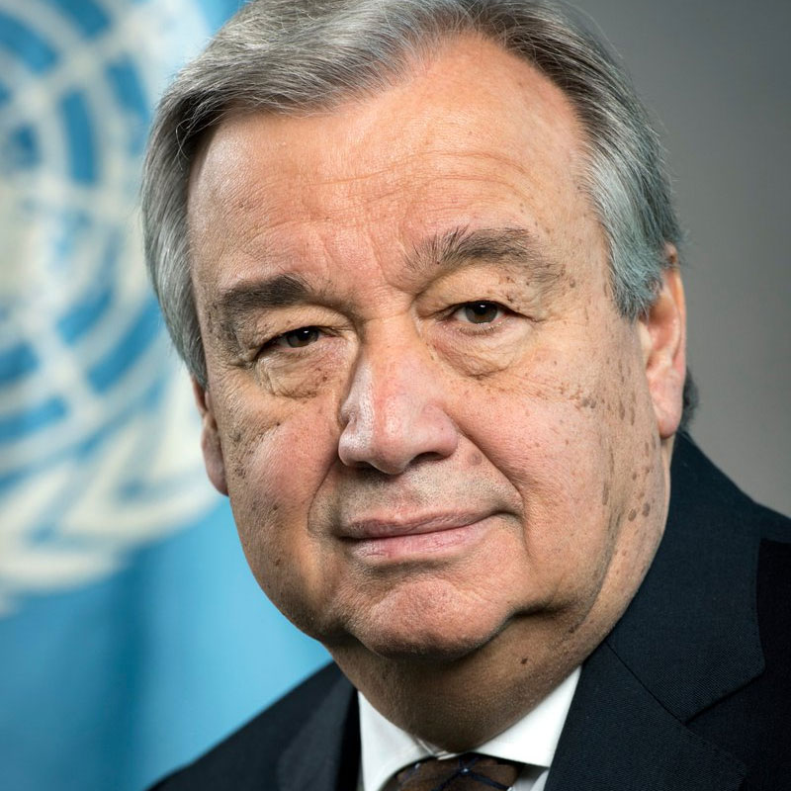
Early Warnings Save Lives
"Early warnings and action save lives. To that end, today I announce the United Nations will spearhead new action to ensure every person on Earth is protected by early warning systems by the end of 2027.”
UN Secretary-General António Guterres on World Meteorological Day (23 March 2022)
$3.1 Billion
of additional funding by 2027
The Early Warnings for All: Executive Action Plan 2023-2027
was released at UNCCC COP-27 and endorsed by all parties.​

Slide 4
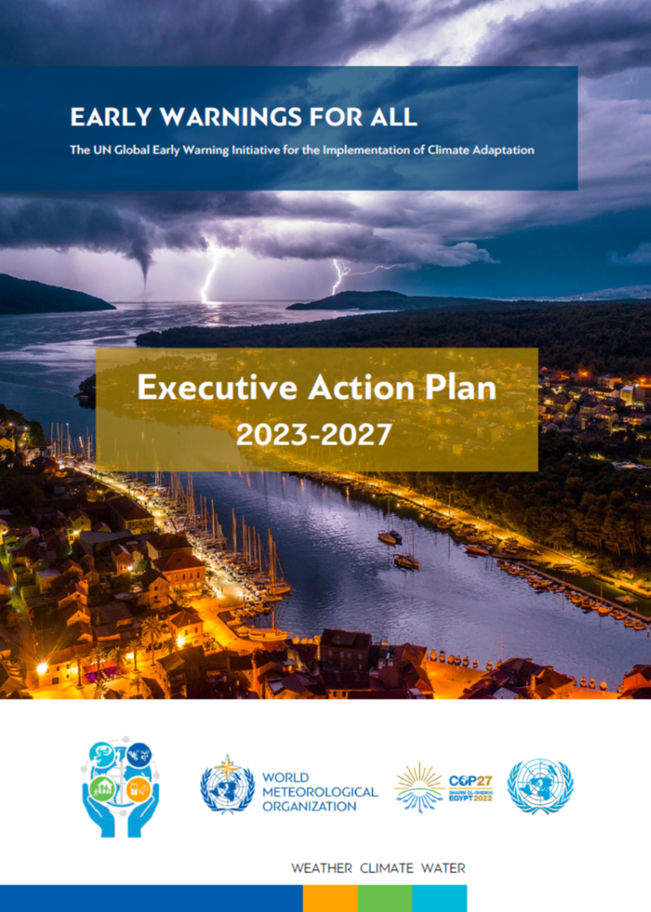
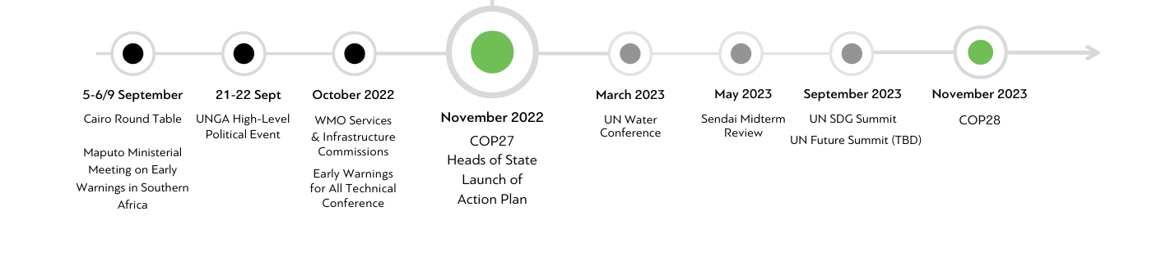
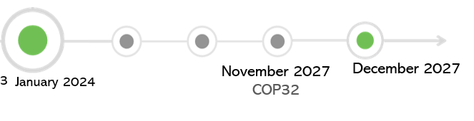

Timeline
Preparatory
Implementation
November 2027
COP32
December 2027
WMO 2024-2027 Financial Period
Notes:
You all heard the background story earlier today, let me just start by highlighting that challenging timeline that we have and how its aligns with and is reflected into our Congress strategy discussions
Executive Action Plan was built by Secretariat and partners, from existing and approved WMO developments and initiatives ,
Countries to prioritize EWS and support NHHS, EW4ALL endorsed by World Meteorological Congress 19 as first priority area for 2024-2027

Slide 5





















Early Warnings for All: Partners
Pillar 1
Led by
Pillar 2
Led by
Pillar 3
Led by
Pillar 4
Led by
Notes:
EW4All is a collaborative space—
partners across sectors drive its success.
Represented are: The private sector
Governments
International development banks
Civil society groups
Non-governmental organisations
Inter-governmental organisations

Slide 6
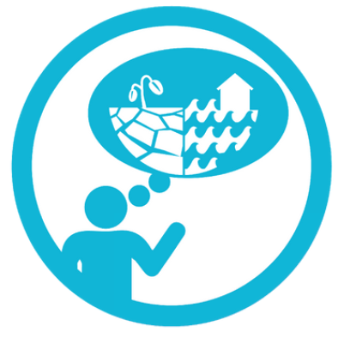
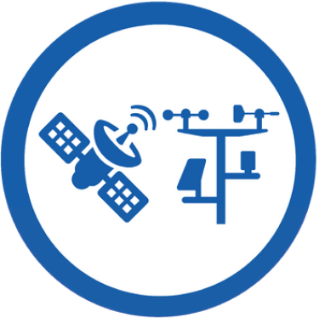
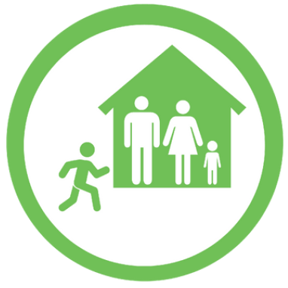
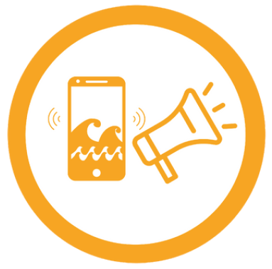
The Four Pillars
Disaster Risk Knowledge
Detection, Monitoring, & Forecasting
Systematically collect data and undertake risk assessments
Develop hazard monitoring and early warning services
Are the hazards and the vulnerabilities well known by the communities?
What are the patterns and trends in these factors?
Are risk maps and data widely available?
Detect
Are the right parameters being monitored?
Is there a sound scientific basis for making forecasts?
Can accurate and timely warnings be generated?
Pillar 1
Pillar 2
An EWS is as strong as its weakest link
Know
Inform
Pillar 4
Pillar 3
Preparedness to Respond
Dissemination and Communication
Build national and community response capabilities
Act
Communicate risk information and early warnings
Are response plans up to date and tested?
Are local capacities and knowledge made use of?
Are people prepared and ready to react to warnings?
Do warnings reach all those at risk?
Are the risks and warnings understood?
Is the warning information clear and usable?

Slide 7

Early Warnings for All: Interpillar Domains
1. Governance, policy & legislation
2. Stakeholder coordination
3. Advocacy & awareness
4. Planning & finance
5. Monitoring & evaluation

Slide 8
Programmatic Approach: Global & Regional Level
Global Level
High-level Executive Action Plan published
Advisory Panel for EW4All initiative & technical-level inter-pillar coordination mechanism
5-year Implementation Plan, including pillar and cross-cutting objectives, outcomes & indicators
M&E Framework: Theory of Change, maturity index, dashboard on country progress, annual report
Interpillar Toolkit to support rollout & implementation
Regional Level
Asia-Pacific regional inter-pillar coordination mechanism among WMO, UNDRR, ITU, and IFRC has been established.
Coordination with UN system and partners in Pacific
Complementarity with Weather Ready Pacific needs to be ensured

Slide 9
Progress of the EW4All Initiative

Slide 10
1- Interpillar Toolkit Updated & Translated
Interpillar tools support country roll out
TORs: National Stakeholder Mechanism, National UN Focal Point
Concept Note & Agendas: National consultative workshop & gap analysis
Templates: stakeholder mapping & national roadmap
Minimum Core Capability Checklist: Pillar and Interpillar
Translations available in French, Russian and Spanish

Slide 11
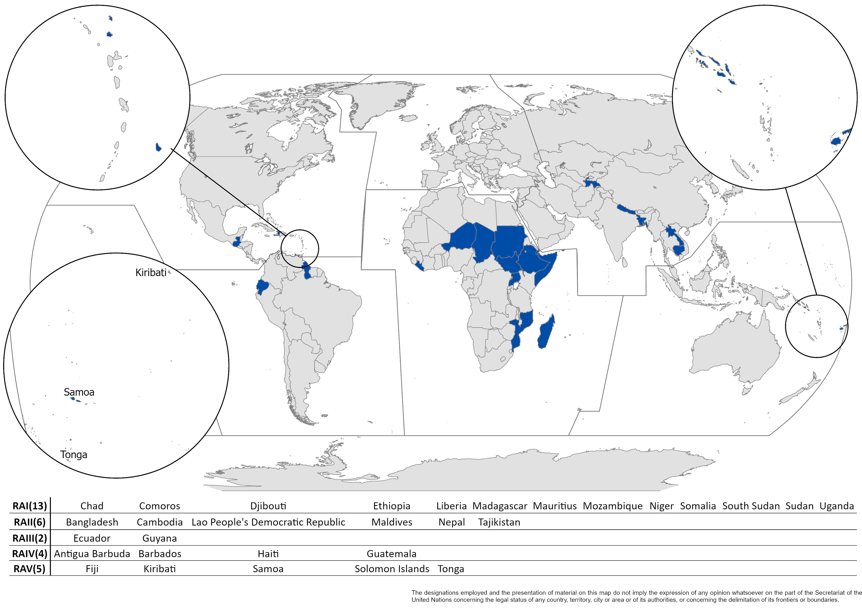
2- Country Rollout in 30 Focus Countries
Notes:
The country roll-out begins with a national consultation workshop, which will agree on a national coordination mechanism, identify key stakeholders and discuss particular needs
Country implementation will prioritise strengthening coordination on EWS across the different sectors and scales (from global and regional to national and local)
National implementation roadmaps will be developed to meet particular country needs
There are existing EWS partnerships like CREWS which is mobilized to support the initial roll-out
Global inter-pillar technical group developed the “toolkit” to help the roll-out at the national level.
Multi-stakeholder consultative workshops
Focus on strengthening coordination across sectors and scales
Identification of gaps and immediate technical support requirements
National roadmap and financing strategies, according to
Funding proposals (i.e. GCF, CREWS)

Slide 12
2- Country Rollout Schedule (10 completed)
04 – 05 JUL | Maldives | National workshop and gap analysis
29 – 30 AUG | Tajikistan | National workshop and gap analysis
30 AUG – 01 SEP | Ethiopia | National workshop and launch of W@H
14 – 15 SEP | Madagascar | National workshop and gap analysis
21 – 22 SEP | Laos | National workshop
21 - 22 SEP | Nepal | National workshop
04 OCT | Cambodia | National workshop and gap analysis
01-02 NOV | Barbados | National workshop and gap analysis
1 – 2 NOV | Bangladesh | National workshop
14 – 16 NOV | Somalia | National workshop and gap analysis
15-16 NOV | Mozambique | National workshop
29 – 30 NOV | Haiti | National workshop and gap analysis
07 – 08 DEC | Antigua & Barbuda | National workshop and gap analysis
Q4 2023 TBC | South Sudan | National workshop and launch of W@H
Q4 2023 TBC | Uganda | National workshop and launch of W@H
Q1 2024 TBC | Guyana | National workshop and gap analysis
*Green rows – completed, Orange rows – scheduled
Notes:
Key Results
High level and technical events
National stakeholder coordination confirmed
Gap analysis
National EWS Roadmap
Next Steps:
Pillar technical support according to country needs

Slide 13
3- Technical Implementation
Lesson Learnt
Transition towards a demand-driven approach to country engagement
Increased systematic engagement of private sector: collaborations underway with DLA Piper, Microsoft, GSMA, Google; sub-working group on AI for EW4All set up
Knowledge management: knowledge-sharing sessions & webinars to disseminate lessons learnt and emerging trends; regular stock-take meetings; documenting learning and best practices

Slide 14
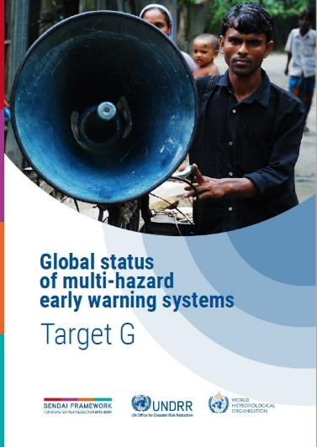
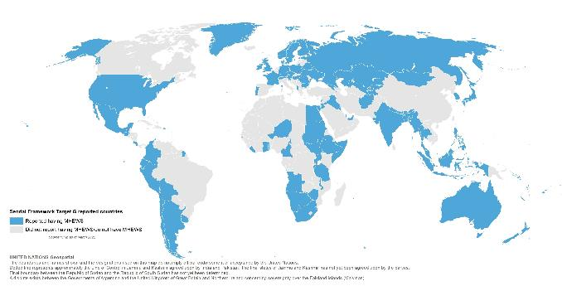
4- Monitoring and Evaluation
A Theory of Change has been developed for the EW4All initiative: Provides an overview of outcomes, outputs and goal of the initiative.
The M&E Framework has been drafted consisting of monitoring indicators defined against the Theory of Change: A common set of indicators can be used across different programmes and projects.
The 2023 Global Status of Early Warning Report has been drafted in consultation with the WG-M&E and several implementing partners: To be launched at COP28.
The EW4All Dashboard is being developed as a tool to monitor progress, ensure accountability, and enhance coordination: To be launched at COP28.
Formulation of the EW4All Maturity Index is ongoing based on the pillar-specific minimum requirements and maturity levels. An initial methodology has been developed for Pillar 2.
Sharing the Progress Towards EW4All

Slide 15
5- Other Milestones
Pillar 1
Handbook on Use or Risk Knowledge for EWS
Pillar 1 country workshops
Cooperation with Microsoft
Handbook on EW in Fragile
Pillar 2
Support for observation networks
WMO standards for alert preparation
Pillar 3
Support to Moldova and Georgia on cell broadcast
New AI EW4All sub-group
Setting up EW4All public-private partnerships
Pillar 4
AA Regional Dialogue Platforms
Global Dialogue Platform to engage the AA community
Notes:
Pillar 2:
Based on the rapid assessment at WMO Congress in May/June, Pillar 2 is prioritizing activities to support countries in developing the observation networks to improve capacities to monitor, forecast and issue warnings for priority hazards they indicated.
WMO standards for alert preparation are under development, and extreme heat and tropical cyclone training package will launch next year.
Existing flooding and marine training materials are being scaled up.

Slide 16
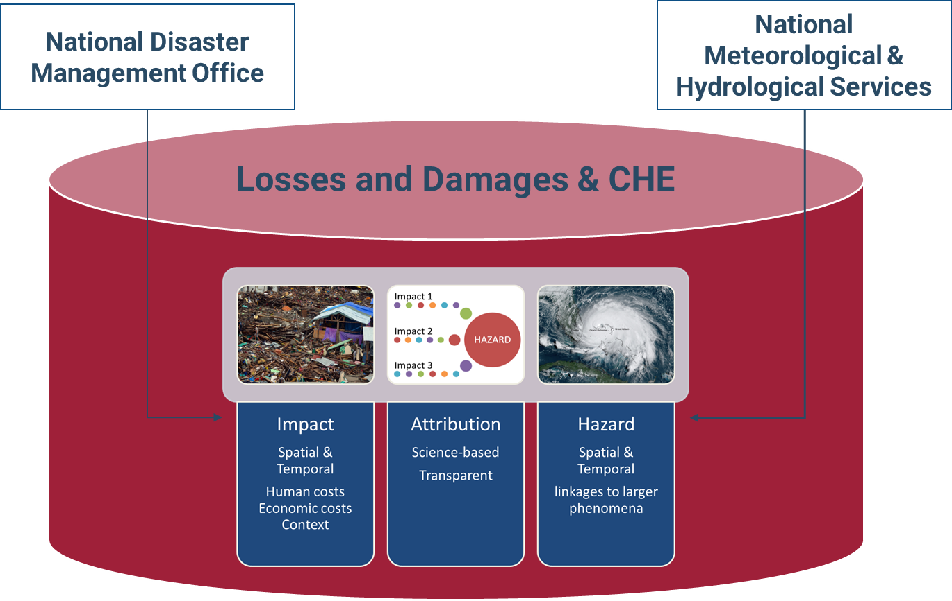
WMO Specific Contribution to EW4All Pillar 1
Tracking system for Hazardous Events and Losses and (UNDP, UNDRR, WMO)
Impact
Spatial &
Temporal
Human costs Economic costs Context
Attribution
Science-based
Transparent
Hazard
Spatial & Temporal
linkages to larger phenomena
Notes:
Combined UNDRR, UNDP and WMO initiative that will provide a systematic and quality-assured methodology and process for recording hazardous events and their related impacts
Fully aligned with the Sendai Framework and related SDG targets and indicators,
Builds off of DesInventar which has been supported by UNDRR with UNDP and other partners for the last 30 years.
Integrated with the WMO Catalogue of Hazardous Events, which will provide authoritative records of weather, climate, and water-related hazardous events at the national and regional levels.
The activity is also part of the work plan of the Technical Expert Group on Comprehensive Risk Management.

Slide 17
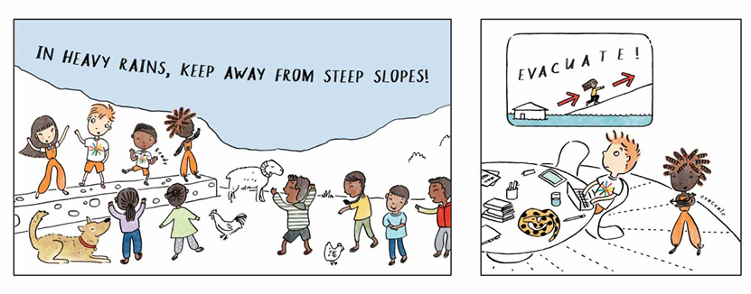
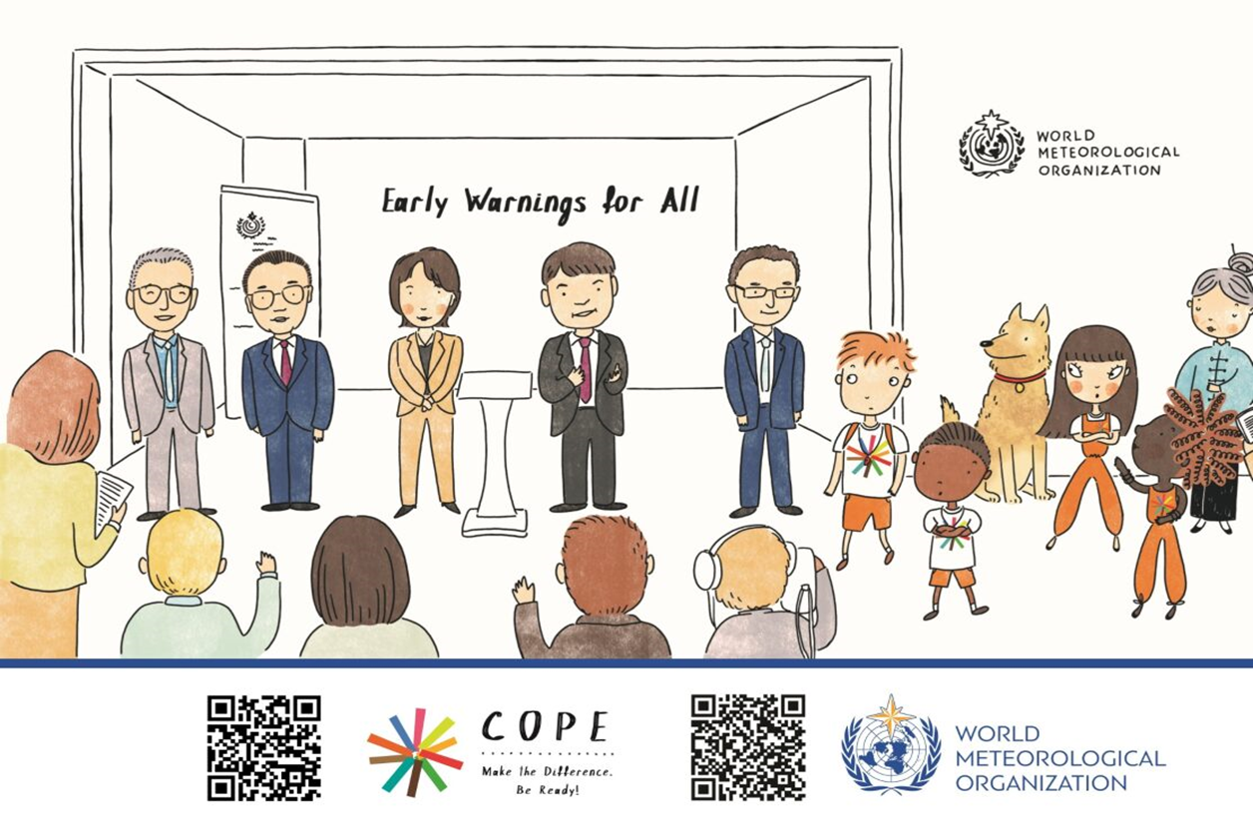

WMO Specific Contribution to EW4All Pillar 1
COPE Disaster Book Series
Notes:
WMO and Hong Kong Observatory are scientific advisor
China (Tsunamis, Droughts), Malaysia (Floods), Singapore, Vietnam (COVID)
All in UN languages,
UNICEF and UNDRR Asia Pacific
Call for more collaboration and outreach activities, share your best practices in empowering youth!

Slide 18
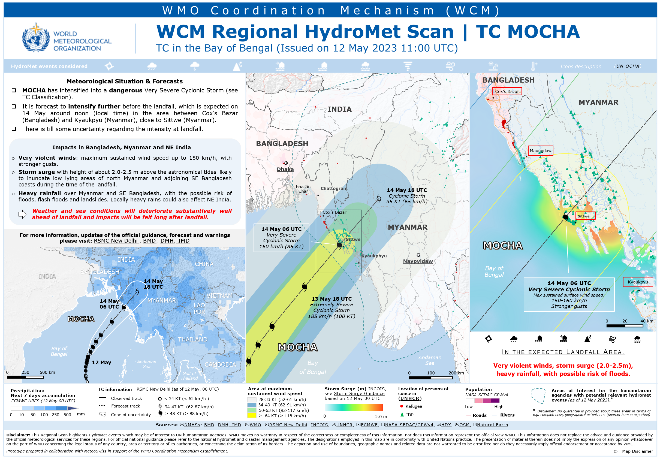
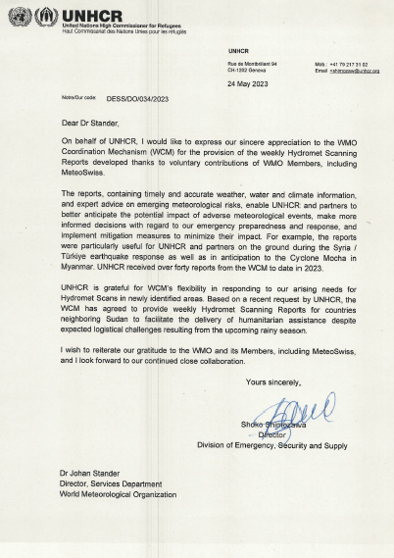
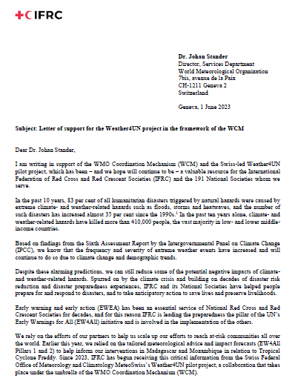
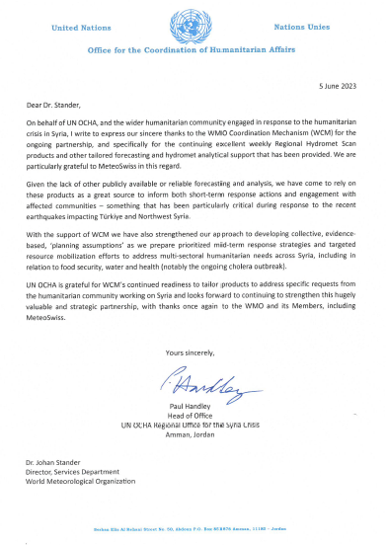
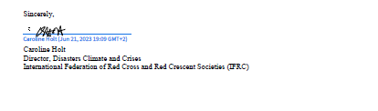
WMO Specific Contribution to EW4All Pillar 1
WMO Coordination Mechanism (WCM)
Weather, water and climate information for Anticipatory Action
WCM Value
Authoritative weather, water, climate information and expert advice to UN and Humanitarian Agencies
Improved Anticipatory Action and Crisis Support
Contributions to the Inter-Agency Standing Committee (IASC), e.g. IASC ENSO Analysis Cell
Notes:
Showcase Mocha, RSMC-New Delhi, Bangladesh Met Services all received appreciation from IFRC, UNOCHA, UNHCR
Call for Typhoon Committee Member’s contribution!
Welcome to join our Coordination and Briefing Team
Raise visibility among UN organizations, develop connections with other met services, and capacity building for members in weather, water and climate service for Anticipatory Actions and Crisis Support

Slide 19
Challenges of the EW4All Initiative

Slide 20
Global Challenges
  Resources mobilization :
    - not all expected support received yet
    - Workshop with funders
  Optimizing our work between the UN level of discussion ( Pillars) and the WMO internal business with SERCOM, INFCOM, RAs as consistency is crucially needed
  Consolidation of the 18 month and 5-year work plan for 30 countries
  Roll out phase with 30 countries will require our time shortly after Congress

Slide 21
Challenges Identified by Members
Sustainability of meteorological infrastructure
Access to new technologies
Capacity development (Forecasters in IBF etc)
Partnerships
New products
Provision of forecasts, early warnings
Resource mobilization
Public communication
Legislation and collaboration
Notes:
Haiti, Guyana, Tonga, Barbados

Slide 22
Way Forward of the EW4All Initiative

Slide 23
1- Technical Implementation
Momentum on country implementation both at the pillar and interpillar level; providing tailored troubleshooting support to countries
Focus on fragile context: Handbook on EWS in FCVs
More systematic engagement with GCF & IFIs: linking initial catalytic work of the pillars to longer terms financing options (e.g. GCF)
Building a knowledge base: Pillar 1 Handbook on Use or Risk Knowledge for EWS; paper on ‘Digital transformation & early warning systems for saving lives’; AI for EWS sub-working group, sectoral guidance, etc.

Slide 24
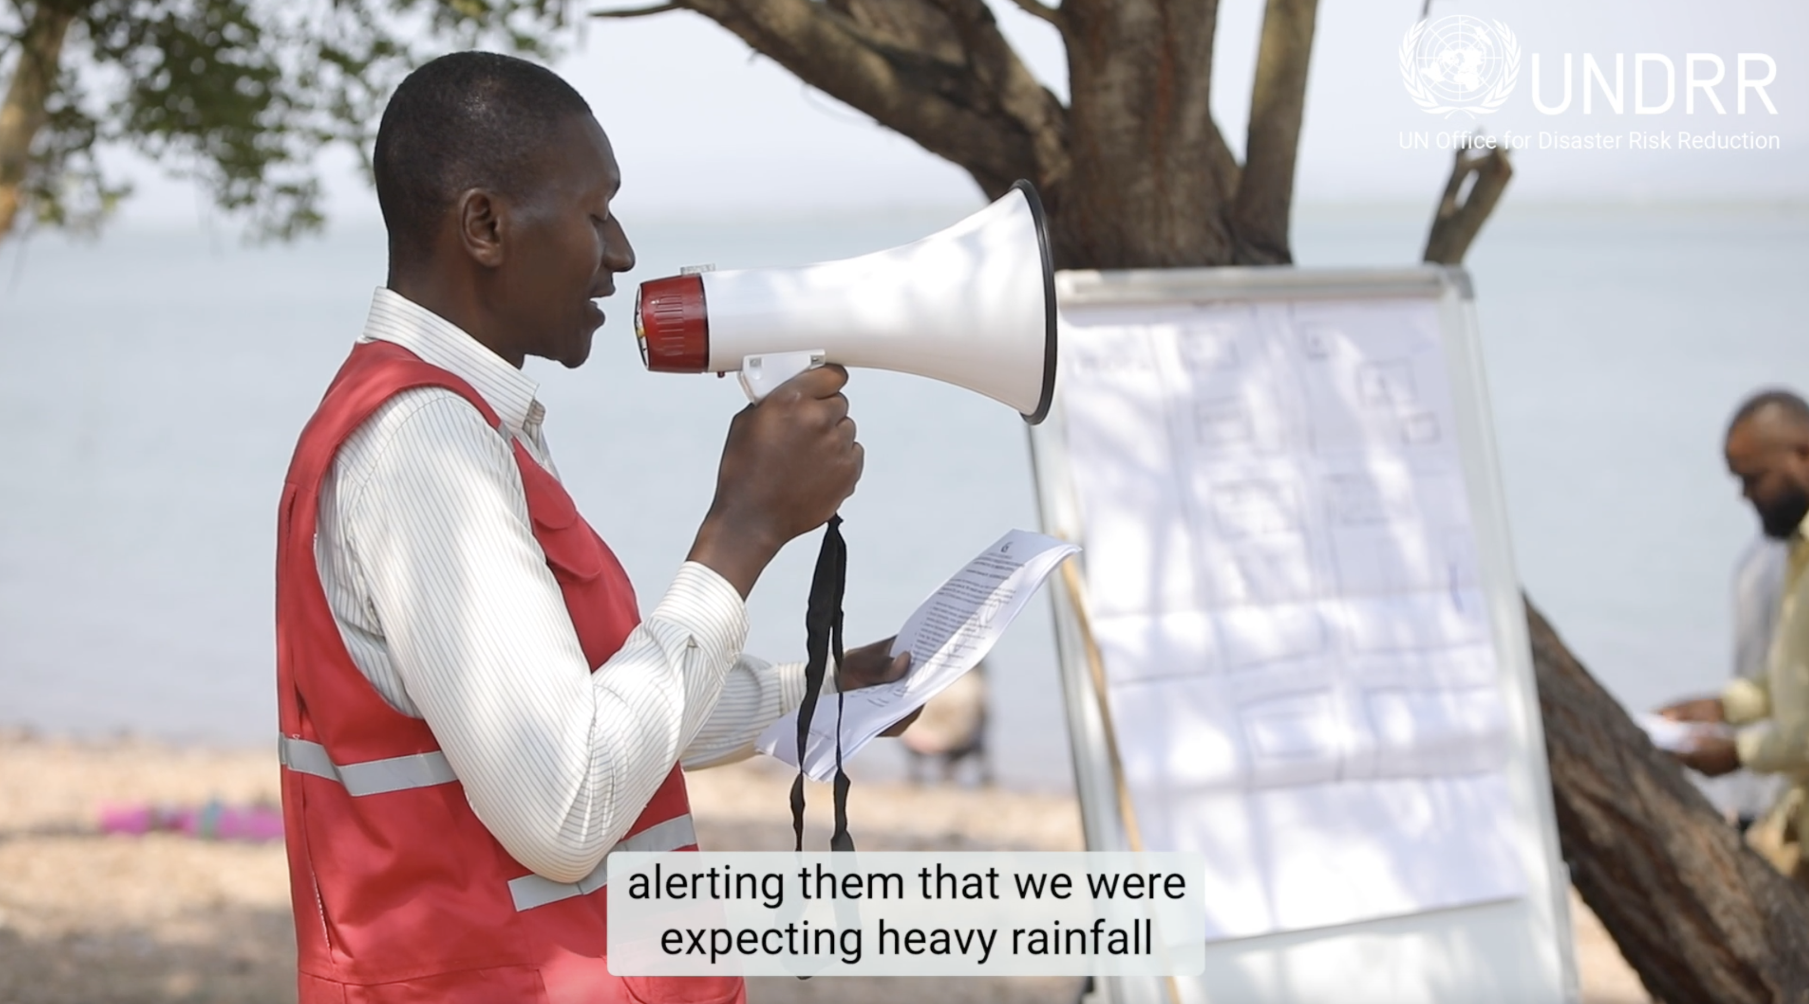
2- Resource Mobilization and Alignment
- Call for critical new investments in the early warning value cycle
- Mobilize the public and private sectors
- Align existing resources & activities​
Bilateral Direct Support
Multilateral Development Banks
Funding
Mechanisms

Slide 25
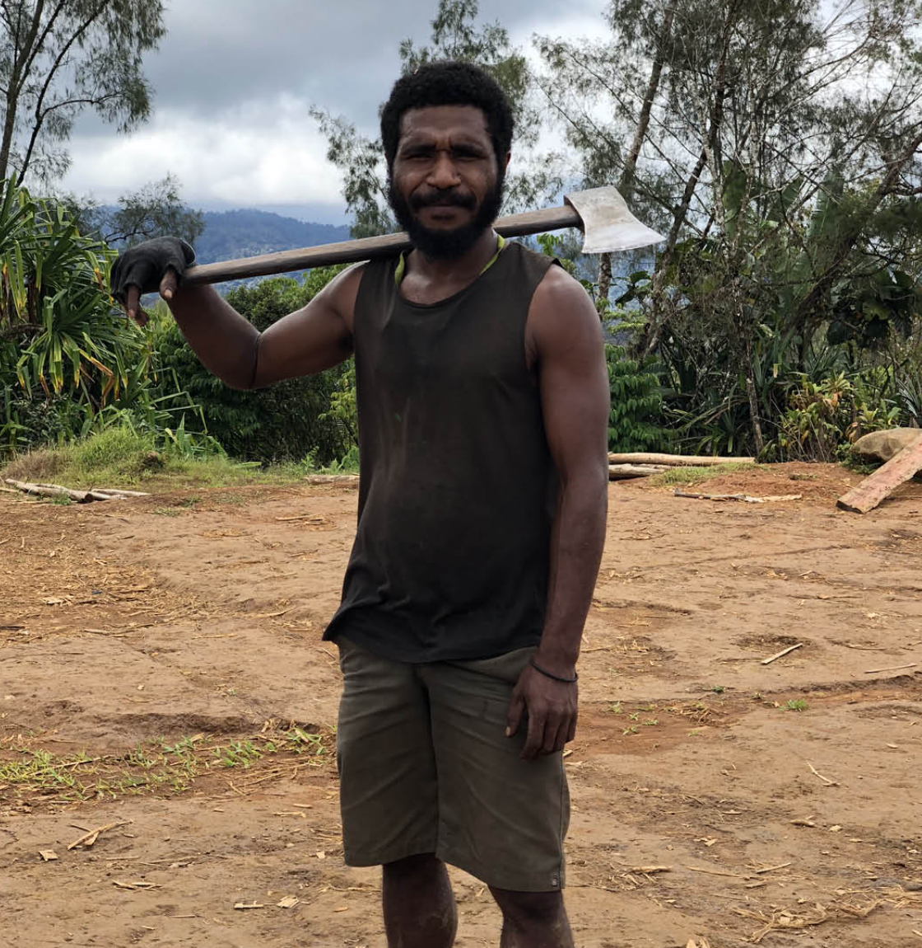
3- Outreach
Work with partners to maximise strengths and avoid duplication
Capacities
Programmes
Resources
Partnerships
Through existing
Leverage innovations and new technologies such as AI

Slide 26
Need for Members to Support, Assist and Implement
Pillar 2
Investment in observing networks and utilization of satellite data
Accelerate data and information sharing infrastructure and usage to support EWS
Expand regional supportive frameworks, including greater geographies and hazards covered
Further develop standards and guidelines for Early Warning Services taking Impact Based approaches
Invest in human capacities and competencies
Scale up work with partners on the Common Alerting Protocol (CAP) (connected to Pillar 3)
Establish CAP Help Desk serving warning emitters and receivers alike
Update the WMO register of alerting authorities and allow connections to redistribution entities such as alert hubs, Big Tech such as Google and Microsoft to scale up official CAP warning usage
 | 26
Notes:
Creating regional hydrological centers as already approved
Expansion of SWFP, where needed, which is already in progress
Inclusion of additional hazards – heat/health impacts
For this to happen, we need the resources at Secretariat to support the implementation of the EWS. We need resources to support the Technical Commissions in further developing technical regulations, standards, guides, guidelines and training materials which are crucially needed to inform and guide the practical implementation at regional and national level. We also need resources to support research to operation transfers, such as the preparation of MTG 3rd generation for countries who may not have capabilities.
In conclusion, 6 key messages
- Trust Secretariat to deliver on its coordination and resource mobilization mandate
- Need for Members to be active participants
- Need for resources
- Leveraging existing mechanisms
- Global , regional and national efforts are needed
- Joined-up approach – INFCOM/SERCOM/RB/RAs/Secretariat

Slide 27

Thank you
Thank you
^{wmo.int}
^{wmo.int}

Slide 28
Why Early Warnings for All (EW4All)
Countries with limited early warning coverage have disaster mortality that is eight times higher than countries with substantial to comprehensive coverage
The number of medium to large-scale disaster events is projected to reach 1.5 per day by 2030
Only half of the countries worldwide report being equipped with the capability to alert their citizens about impending hazardous weather conditions
Early warning coverage is less than half in Least Developed Countries and only one-third among Small Island Developing States

Slide 29
Early Warnings Pay Off
Category of countries by coverage of MHEWS | Mortality per 100,000 population, 2005 - 2022 | Affected population per 100,000 population, 2005 - 2022
Limited to moderate coverage G1= 0 to 0. 5 | 4.05 | 3,132
Substantial and comprehensive coverage G1= 0.5 to 1 | 0.71 | 688
Countries with limited to moderate MHEWS coverage have a nearly six times higher disaster-related mortality ratio compared to that in the countries with substantial to comprehensive coverage
Countries that have limited to moderate MHEWS coverages have nearly five times more disaster-affected people per capita than countries with substantial to comprehensive coverage

Slide 30
Hidden Costs of Cascading Effect on the Socio-economic System
Health,
Economic development,
Loss of income,
Disruption of the welfare
Displacement and the conflict to access the limited resources.
The damage to the
environment,
Environment and biodiversity loss,
pollution of soil, water, and air,
Requires:
all of society approach to identify real loss and damage, as well as to identify and implement the appropriate solutions
Resilience dividends approach

Slide 31
Goals for EW4All
All countries have accessible, understandable, usable and relevant disaster risk information and assessment available to people at national & local levels
All countries have multi-hazard impact-based forecasting & monitoring capabilities
All countries' governments have a plan to act on early warnings
All people at risk can be reached and will receive an alert that they can understand and act upon
All populations exposed to or at risk from disasters are protected through pre-emptive evacuation following early warnings
  EW4All is not a programme.
  It is our collective target towards which we can all contribute—
  no green light required.
UNDRR and WMO (2022) "Global Status of Multi-Hazard Early Warning Systems: Target G", UNDRR

Slide 32
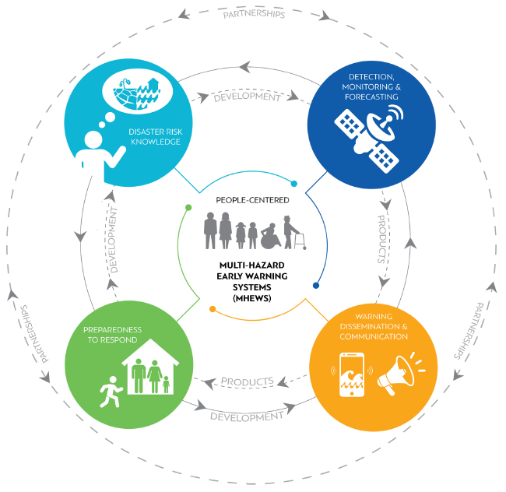
People-Centred MHEWS
Locally-led action is crucial for implementation
Civil society engagement required to turn
“last mile” communities into “first mile” actors
Warning information to be:
Customised
Disseminated
Understood
Acted Upon

Slide 33

Development Approach
  Pillar implementation strategies developed and coordinated across pillars considering activities from global to national level
  Derive national action plans based on country needs and priorities (hazards), leveraging and complementing existing initiatives such as Weather Ready Pacific
Notes:
EW4All contextualization to countries
Pillar implementation strategies developed and coordinated across pillars [global]
Derive national action plans based on country needs and priorities (hazards)complementing existing initiatives

Slide 34


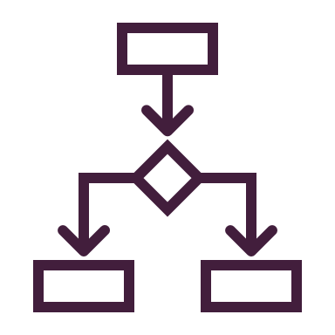

Interpillar Technical Coordination
Programming Approach
Interpillar Toolkit
Country Rollout
Convening a network of partners
Developing joint tools and guidance
Programming of country work
5-year Implementation Plans at pillar and interpillar level
18-month budgeted workplans
Interpillar toolkit
Minimum core capability checklist for gap analysis
TOR for national stakeholder coordination mechanism
Template for national roadmap, etc.
Stakeholder mapping
National consultation workshop
Gap analysis
National EWS Roadmap

Slide 35
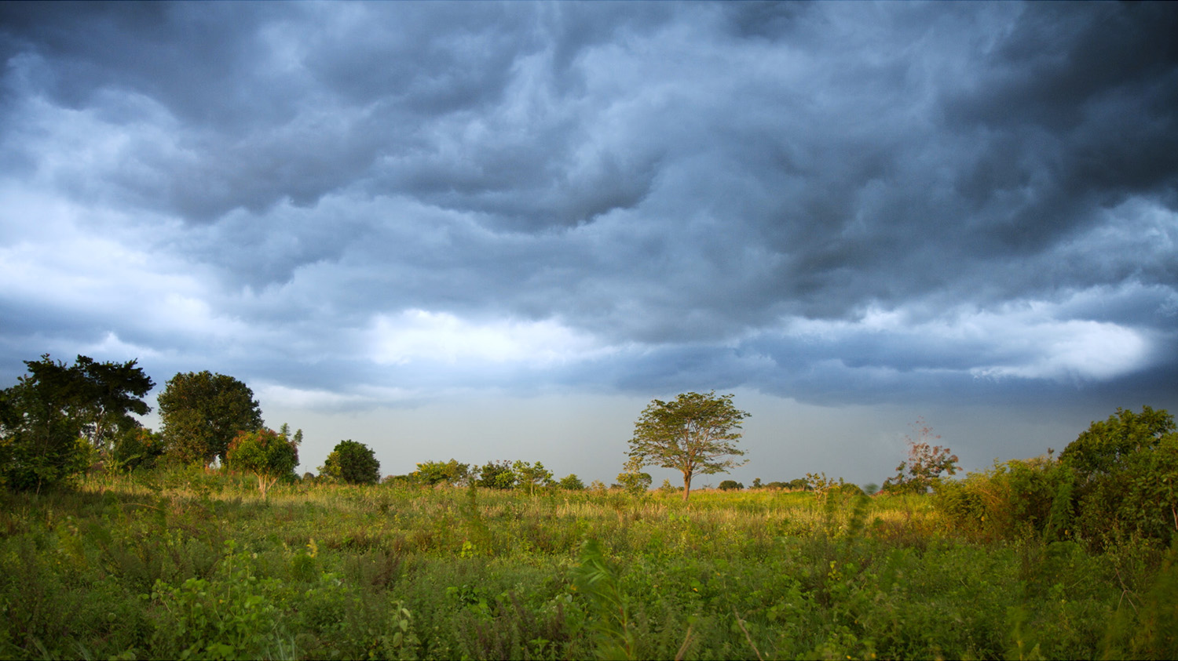

NATIONAL WORKSHOP ON EW4ALL
COLLECTIVE OUTCOMS & LESSONS LEARNED
EWS CURRENT STATE
LINK AND ALIGNMENT
COORDINATION MECHANISM
Take stock of the current state of EWS and promote a shared understanding of progress in implementation
Explore linkages and alignment among ongoing and upcoming initiatives, and consolidate key stakeholder commitments to strengthen national and sub-national EWS
Affirm or establish national coordination mechanisms to facilitate multi-stakeholder efforts to scale-up end-to-end EWS, linking national and local engagement.
PRIORITY AREAS
ADDRESSING KEY CHALLENGES
NATIONAL ROADMAP
Agree on a process for identifying priority areas for action to address national EWS gaps (informed checklist tool);
Identify key barriers to risk-informing, issuing, communicating and acting on early warnings effectively; recommend targeted actions to overcome these, in line with national priorities
Leverage existing EWS strategy or develop a multi-year, multi-stakeholder EW4All national action plan to marshal coordinated resources, technical assistance and long-term support

Slide 36
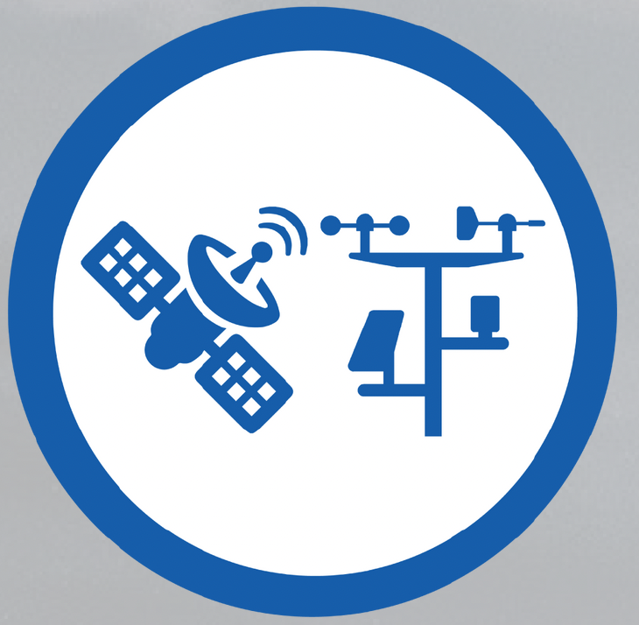
Pillar 2 Implementation Strategy
Outcome 1: Observations meet the data requirements to monitor high-impact hazards
Outcome 2: Enhanced global, regional and national data management and processing for forecasting and warning systems
Outcome 3: All priority hydromet hazards are forecasted
Outcome 4: Warnings produced and disseminated in an efficient and timely manner for all priority hazards
Outcome 5: Relevant policy, institutional mechanisms and stakeholder engagement processes are in place to support MHEWSs

Slide 37

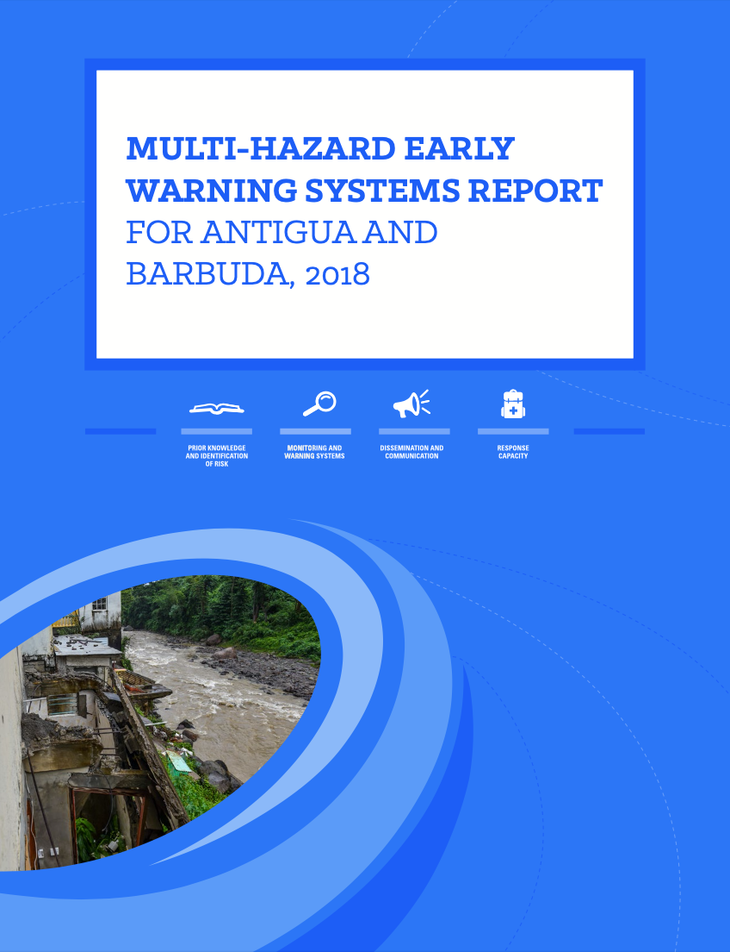
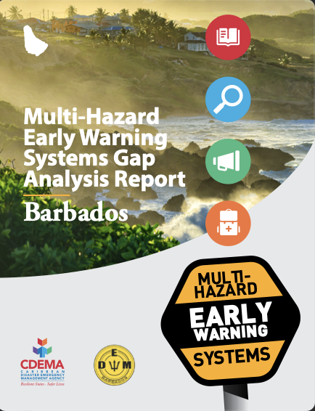
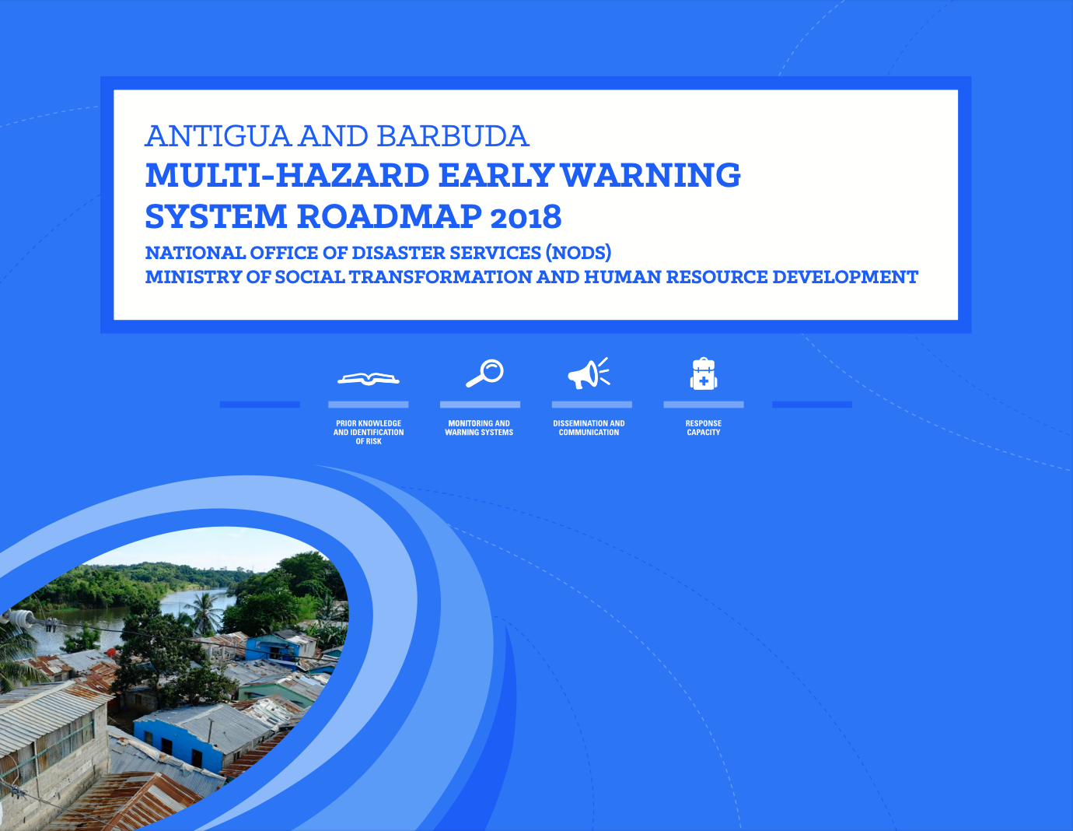
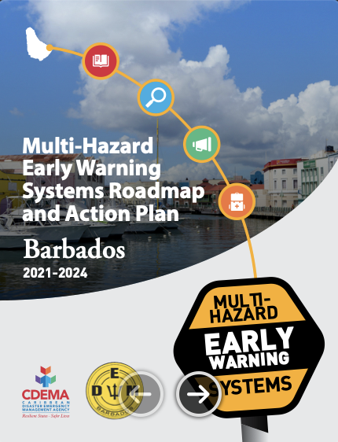

Designed process for the implementation of the roll-out phase
Step 1:
Gap Analysis
(update/revision)
Step 2: Roadmap Design
(update/revision)
Step 3: Budgeting of Activities
Step 4: Preparation of Project Proposals
Step 5:
Roadmap
Implementation
6 months – End of 2023
6-12 months – mid 2024
3 Years
Sustainability

Slide 38
Multistakeholder Fora (MSF)
Organised to enhance consultation and foster collaboration with a wider group of partners.
2017-
2022
2024
2025
2026
2027
2030 & beyond
3 Multi-hazard Early Warning Conferences
Organized as preparatory event in the context of the Global Platforms for DRR (2017, 2019, 2022). These events were organized by UNDRR, UNOOSA, WB & WMO and other partners.
2025 EW4All MSF (June)
The first global MSF will be organized as preparatory event during the Global Platform for DRR. The event will reflect on the implementation of all four pillars of EW4All initiative.
2027 EW4All MSF
The 2027 MSF will review the progress of the EW4All initiative and remaining challenges.
2024 Regional MSF
Regional EW4All MSF will bring together early warning partners & stakeholders to exchange on regional specific experiences, good practices and share progress made. The outcomes will inform the 2025 global MSF.
2026 EW4All MSF
The second global MSF will showcase good practices and discuss how to bridge gaps.
Achieving Sendai Framework Target G
Achievements of the EW4All inititiaves and complementary efforts will be assessed during the 2028 Global Platform for DRR. How to address remaining gaps until 2030 and how to maintain successes will be a critical part of the discussion.
Regional and National efforts will feed into the EW4All MSF including Regional Platforms for Disaster Risk Reduction, Regional Sustainable Development Forum, WMO meetings, IBCs, etc.

Slide 39
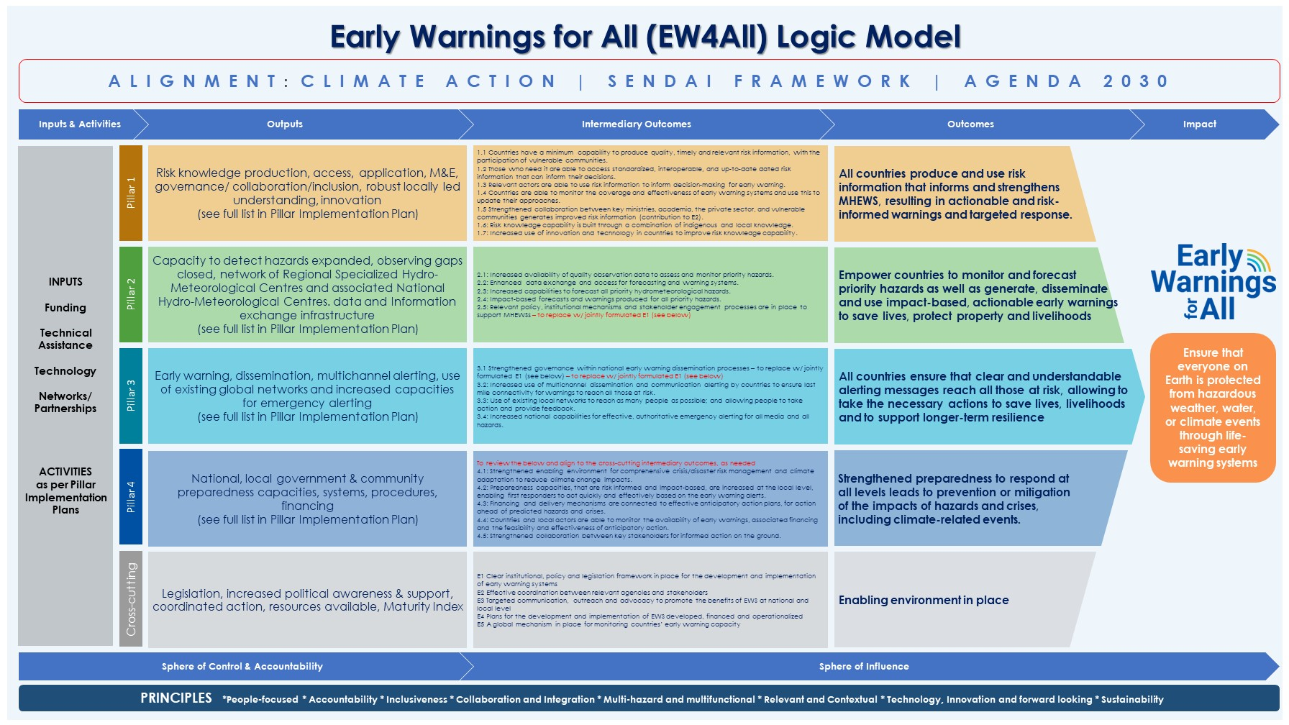
4- Monitoring and Evaluation
Notes:
Status:
Monitoring indicators defined at outcomes/output level
Indicators on cross-cutting elements like governance and enablers drafted
Next Steps:
A Monitoring Plan being developed:
data availability, source, method, reliability
Challenges:
Establishing a baseline: data missing on many indicators
Evolving metrics that will become progressively available

Slide 40
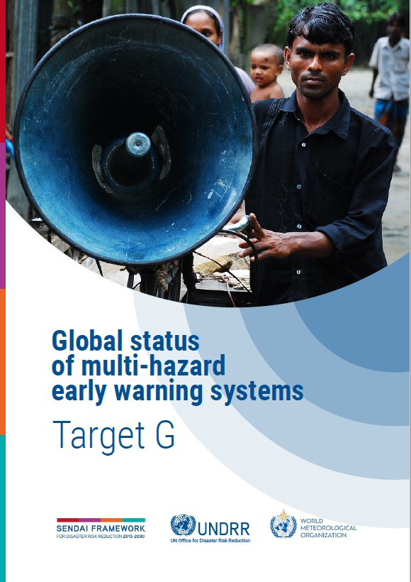
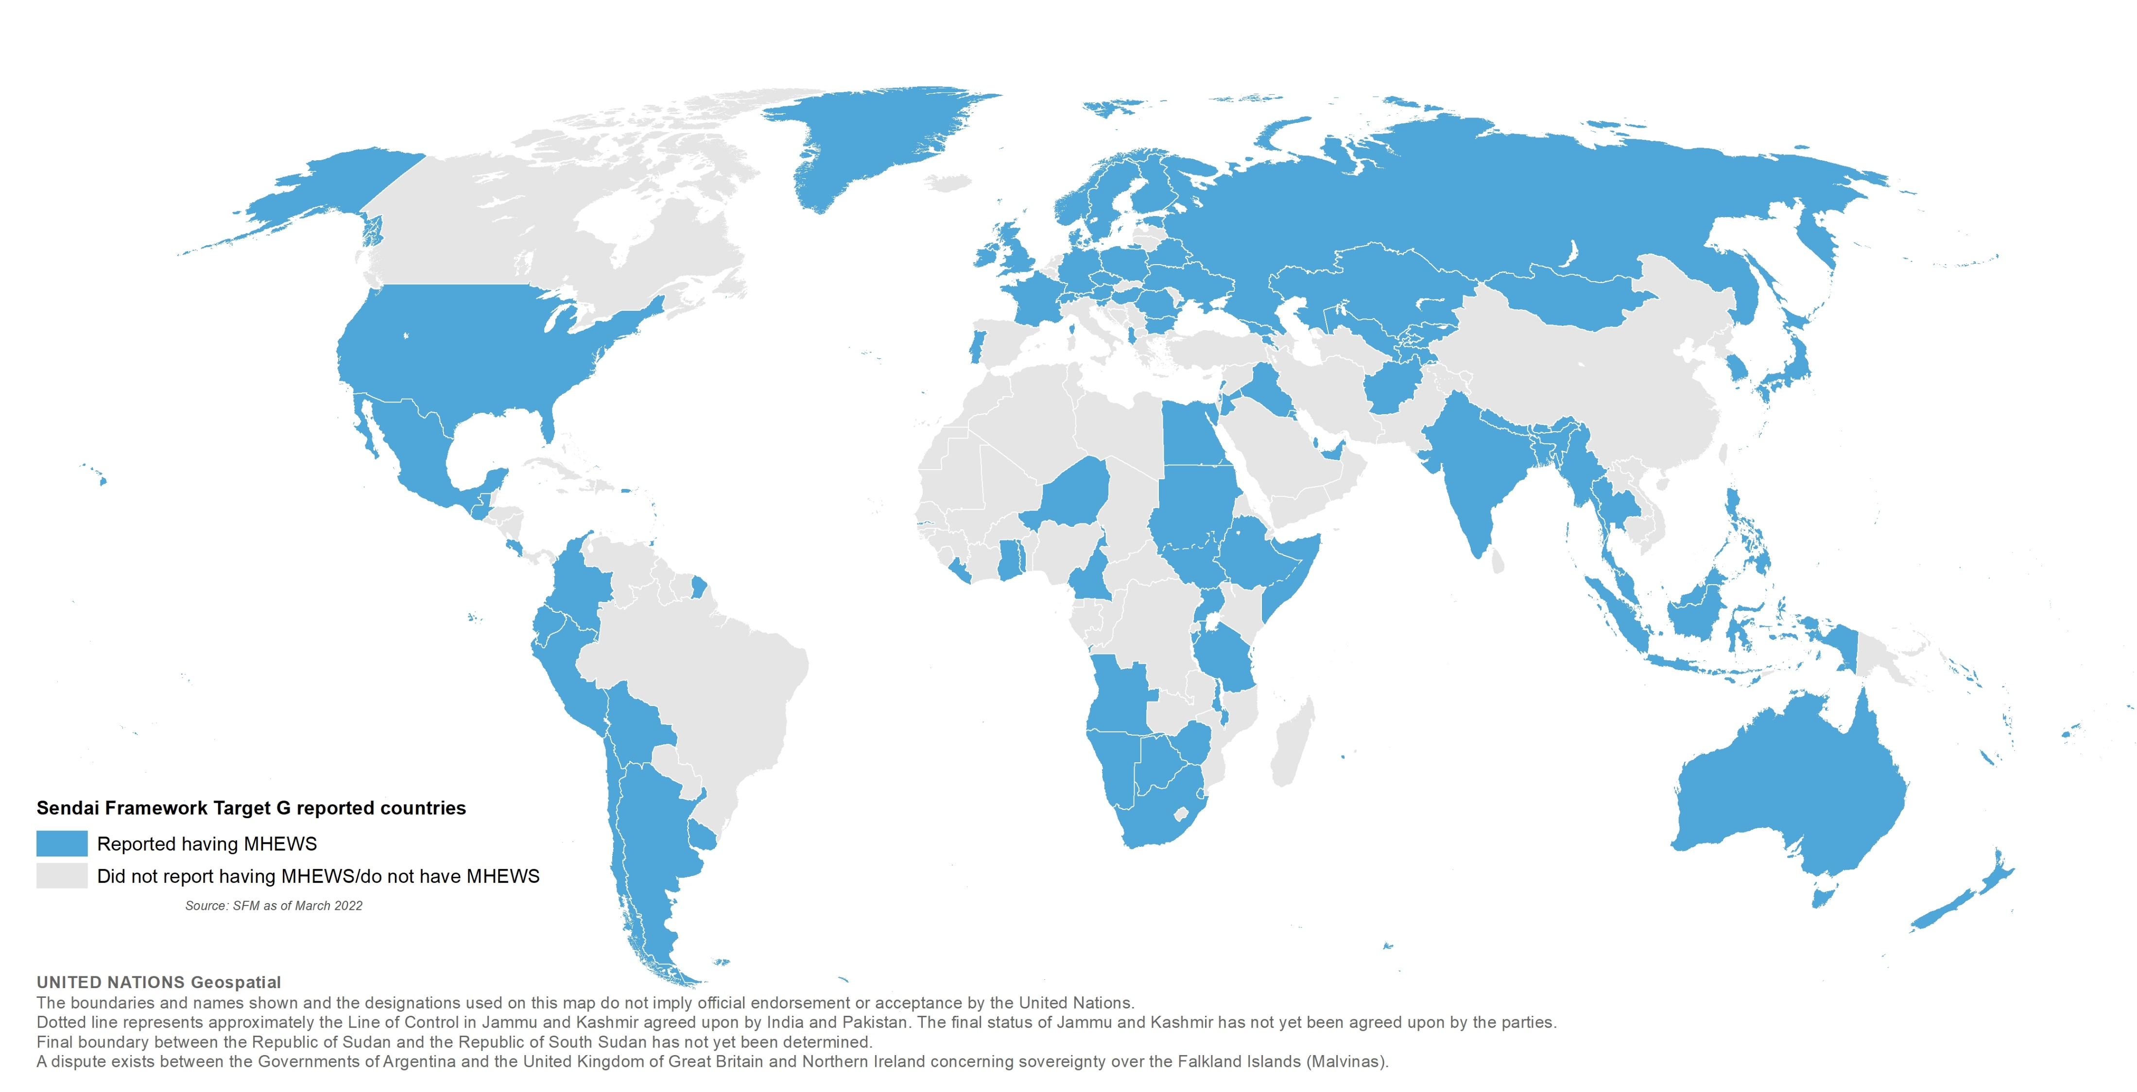
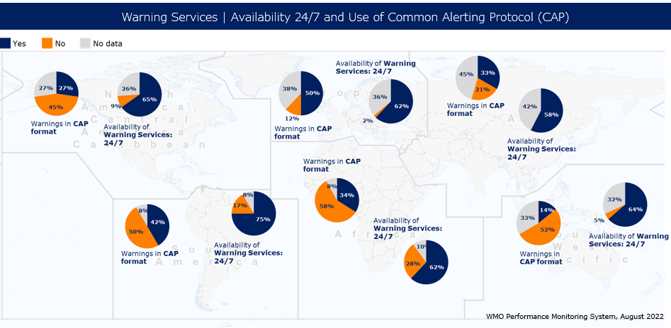
4- Monitoring and Evaluation
Sharing the Progress Towards EW4All
Global Status Report
EW4All Dashboard
Sharing of most updated status based on the EW4All M&E Framework
2023 report has been drafted
Both report and dashboard to be launched at COP28

Slide 41
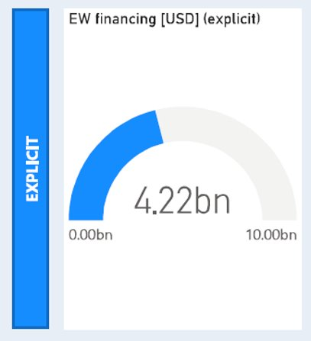
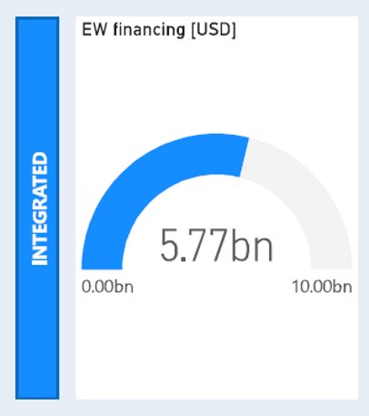
Upcoming Funding Opportunities
Commitment not to develop new funding mechanisms for EW4All, but to scale-up existing mechanisms, while ensuring coordination.
Resource mobilization and alignment strategy: focus on supporting countries to mobilize and align the USD 3.1 billion of additional investments required.​
Exploring new partnership to help mobilize quality funding.
New projects with GCF

Slide 42
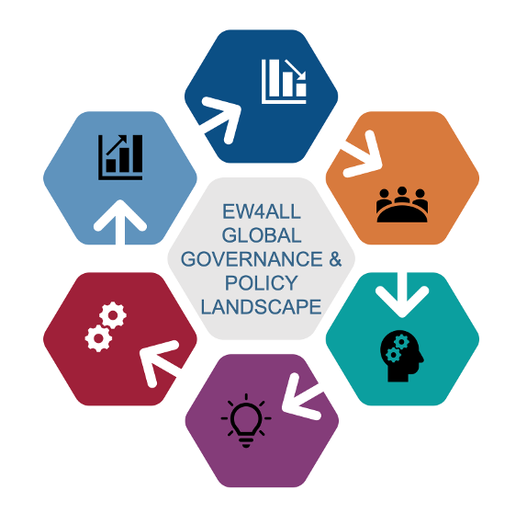
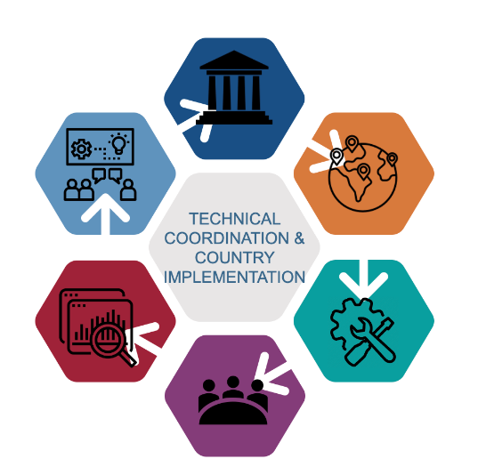
EW4All Governance Structure
Joint advocacy & communication
EW4All Global Governance & Policy Landscape
Technical Coordination & Country Implementation
Joint monitoring & reporting
UNSG & Co-Leads United Nations Secretary-General (represented through the Climate Action Team) nominated WMO & UNDRR to co-lead the EW4All initiative with partners
Advisory Panel Assesses and presents annual progress reports ahead of UNFCCC COPs and offers guidance on resource mobilisation | Global Partnership Coordination WMO and UNDRR chair quarterly EW4All coordination meetings to guarantee close coordination between global partners and partnerships on early warning | Interpillar Technical Coordination Pillar leads (UNDRR, WMO, ITU & IFRC) meet weekly to ensure technical alignment, timely execution of joint implementation plans and coordinated programming
Pillar Working Groups Pillar leads meet with their pillar partners biweekly on matters pertaining to implementation | Multistakeholder Fora Review key accomplishments, share skills, experience and expertise within an active network of early warning practitioners | Interpillar Country Implementation Global, regional & country-level country rollout programming such as national workshops, gap analysis & national roadmap development, using EW4All toolkits and implementation modules to build on existing efforts

Slide 43
EW4All Advisory Panel Members
Chief of Communications & Results Reporting, ASG Development Coordination Office
USG for Humanitarian Affairs and Emergency Relief Coordinator, OCHA
Executive Director, GCF
Chair, SOFF
Chair, CREWS
Vice Chair and President, Microsoft
Director General, GSMA
Chair, Insurance Development Forum
Rotational Members
Regional Development Bank
Civil Society Representative
Youth Representative
Current and incoming UNFCCC COP Presidency
Co-Chairs
Special Representative of the Secretary-General for Disaster Risk Reduction, UNDRR
Secretary-General, WMO
Members
The Secretary-General of the United Nations
Special Adviser to the Secretary-General on Climate Action and Just Transition
Chief Executive Officer and Secretary General, IFRC
Secretary-General, ITU
Administrator, UNDP
Executive Director, UN Women
High Representative, UN-OHRLLS

Slide 44
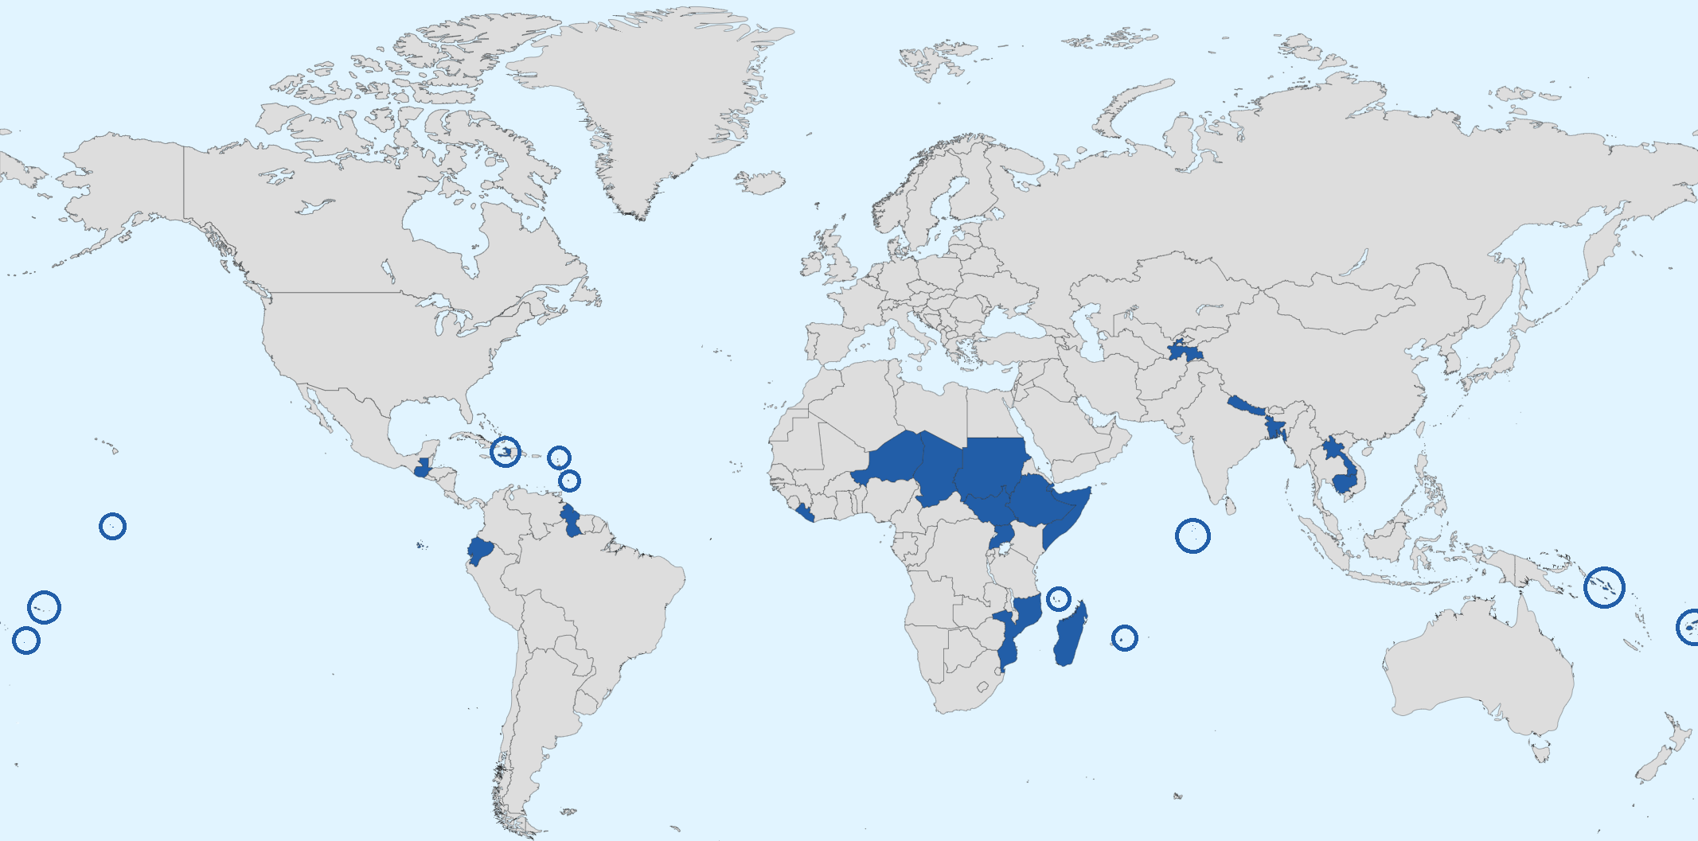
Building Capacity on the Ground
Countries and regions have unique challenges in implementing MHEWS
Individual country roll-outs for EW4All help to:
Host national workshops to facilitate adoption
Activate existing DRR networks via focal points
Allocate funding for initial 30 countries (with plans to expand to any interested nation)
  Priority for least-developed, landlocked developing, and small island developing countries
The boundaries shown and the designations used on this map do not imply official endorsement or acceptance by the United Nations.

Slide 45
The Road to Building Capacity
Gap Analysis
Roadmap Design
Budgeting of Activities
Preparation of Proposals
Roadmap Implementation
A Toolkit was developed by the Interpillar Technical Coordination group to streamline the process for national roll-out
Toolkit Includes:
Gap analysis
Concept notes
Agendas for workshops
Workshop presentation materials
Stakeholder mapping
National EWS road maps
Terms of reference for stakeholder coordination
Terms of reference for UN focal points
Not every country needs every component—it depends on the existing capacity ​

Slide 46
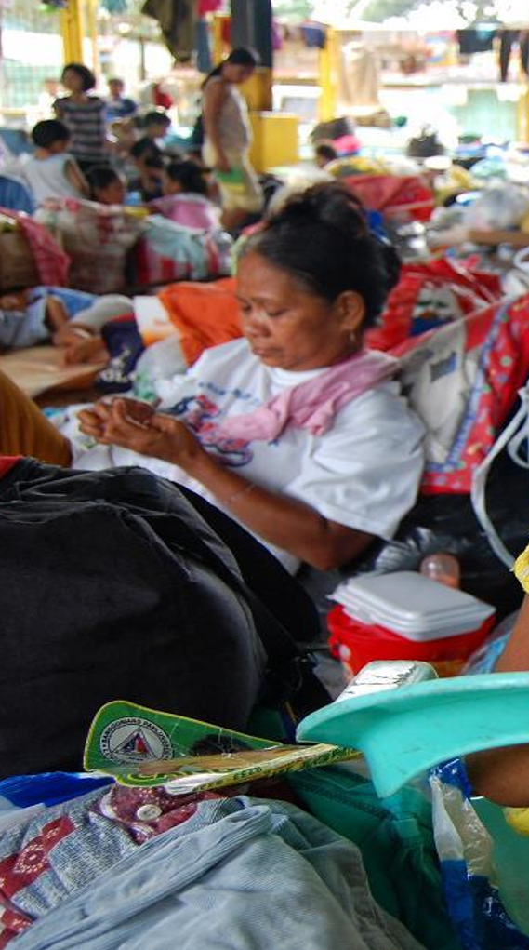
4- Strengthening Partnerships
Regional Offices to ensure that country level work consists with the regional and national priorities and contexts
Organization of multistakeholder fora, first at the regional (2024) and then global (2025) levels, serve as an opportunity to strengthen existing partnerships & build new ones across sectors.

